Slide 1
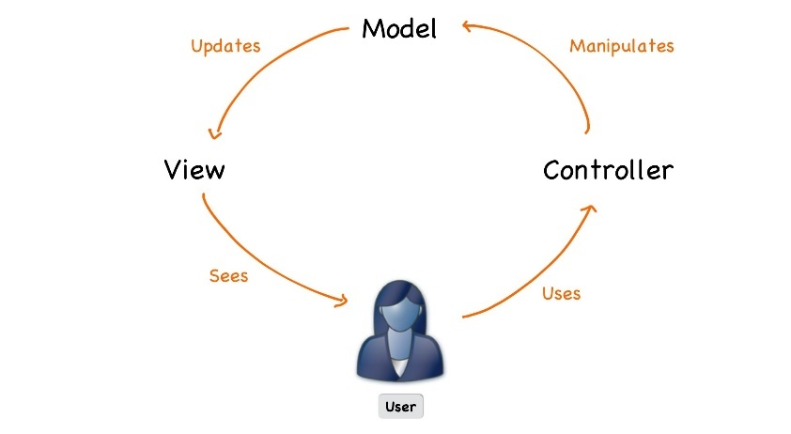




C# Web Development Basics
Course Introduction
SoftUni Team
Technical Trainers
Software University
http://softuni.bg

Slide 2
Table of Content
C# Web Module @ SoftUni
4 Months Web Development Training
C# Web Development Basics
Course Objectives & Program
The Module Team
Evaluation

Slide 3













SoftUni Diamond Partners

Slide 4





SoftUni Organizational Partners

Slide 5
Questions
sli.do #csharp-web

Slide 6

C# Web Module @ SoftUni
4 Months Web Development Training

Slide 7
C# Web Module Goals
"C# Web" Module @ SoftUni
4 times weekly, mainly practical exercises
Part I – Web Development Basics
Web Fundamentals, HTTP Protocol, Hand-Made Web Server, Hand-Made MVC Framework
Part II – MVC Frameworks
Essentials, View Engines, Security, Architecture, Unit Testing, Services, Control Flow, Deployment

Slide 8
C# Web Module at SoftUni – Timeline
17-September-2018
04-November-2018
December-2018
C# Web Development Basics
Lessons + exercises + exam
6 weeks * 4 times / week
12 credits
Start: 17-September-2018
Exam: 04-November-2018
C# MVC Frameworks
Lessons + exercises + exam
6 weeks * 4 times / week
18 credits
Start: 05-November-2018
Project Defense: TBA
C# Web Re-Take Exams
First week of January 2019

Slide 9

C# Web Development Basics
Course Objectives & Program

Slide 10


C# Web Dev Basics – Course Program
Course Introduction – Course Program, Trainers, Exams, Resources
Web Fundamentals Introduction – HTML & CSS
Web Server: HTTP Protocol – Building a simple Web Server? What is HTTP?
Web Server: Async – Working with multiple clients…
Web Server: State Management – Cookies & Sessions
Web Server: Databases – Including EF Core
Workshop: Web App with Bootstrap – Creating a Simple Web Application with the Server from Scratch, and designing pages.

Slide 11



C# Web Dev Basics– Course Program (2)
Introduction to MVC – Creating a Simple MVC Framework
Advanced MVC Framework – Extending the MVC Framework
Workshop: MVC – Lots of practical 4-hour coding lessons
Exam Preparation

Slide 12


The Module Team

Slide 13
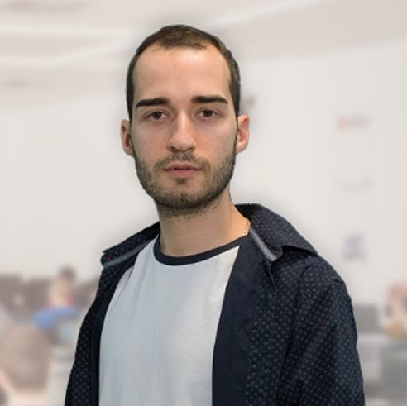
Module Team (Trainers)
Nikolay Kostov
Solutions Architect @ ZenCodeo
15+ years in the IT
Developer, Manager, Trainer, Architect
Аctive role in the development of the Judge platform - https://judge.softuni.bg/
Microsoft Certified Trainer
Personal blog: nikolay.it

Slide 14

Module Team (Trainers)
Svetlin Galov
Full-Stack Web Developer @ SoftUni
3+ years in the IT
Top performing student of SoftUni
A passionate .NET Guru

Slide 15

Module Team (Materials & Resources)
Ivaylo Jelev
Training Team Leader @ SoftUni
5+ years in the IT
3+ years as a Technical Trainer @ SoftUni
Professional Problem Creator (Exam & Exercise Problems)
Interested in Game Development

Slide 16

Module Team (Materials & Resources)
Mirela Damyanova
Training Assistant @ SoftUni
Graduated Student from SoftUni
Loves helping students
Interested in Blockchain & Algorithms

Slide 17

C# Web Dev Basics: More Details
Duration, Schedule, Languages, etc.

Slide 18


Training Duration – C# Web Dev Basics
Lessons: ~50 hours (onsite + videos)
Practical exercises (in class): ~60 hours
Exam preparation: 3*4 hours
Exam: 6 hours
Schedule: September – November 2018
Exam date: 04 November 2018

Slide 19



Learn to Search in Internet & Find Solutions!
The course assignments require to search in Internet
This is an important part of the learning process
Some exercises intentionally have no hints
Learn to find solutions!
Software development includes everyday searching and learning
No excuses, just learn to study!
Developers learn new technologies, tools, languages every day!

Slide 20

C# Web Dev Basics
Evaluation Criteria

Slide 21


Scoring System for “C# Web Dev Basics”
Exam – 90%
Homework (exercises) – 10%
Bonuses: up to 10%
Presence in class: 5% (onsite students only)
Forum activities
Others

Slide 22
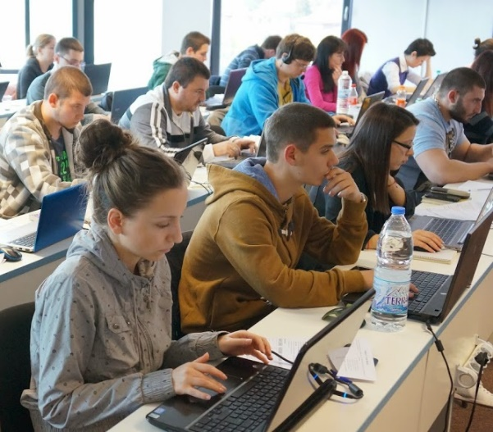

C# Web Development Basics Exam
Practical web development exam
Implementing a simple web application
Given the MVC Framework and Web Server
Given a portion of the Views in a raw form
Duration: 6 hours.
Solutions are evaluated by hand after the exam

Slide 23

Homework Assignments
Doing your homework is very important!
Programming can only be learned through a lot of practice!
You should write code every day!
Each lesson is followed by many exercises
Try to solve them in class
The rest are your homework
Homework assignments are due in 6 days after each lecture
Submission are sent on the course page at softuni.bg

Slide 24

Resources
Resources
What We Need Additionally?

Slide 25


Your RFID Chip
Students can either
Take RFID chip from SoftUni
Or use their own chip / card
Register your chip number in your SoftUni profile: https://softuni.bg/users/profile/show
Check-in at the reception every time when you come
See your last visits in your profile: https://softuni.bg/users/profile/show

Slide 26



C# Web Dev Basics Site, Forum and FB Group
Official web site:
Official discussion forum:
Official Facebook groups:
https://softuni.bg/courses/csharp-web-development-basics
https://softuni.bg/forum/categories/66/csharp-web-development-basics
https://www.facebook.com/

Slide 27



The C# Web Slides and Videos
All lecture slides, videos, homework assignments, projects and other resources are open content, available for free
Visit the course web site to access the course resources

Slide 28

Software University Learning System (SULS)
Software University Learning System (SULS)
www.softuni.bg
Important resource for students
Homework submissions
Homework check-up
Exams and results
Reports about your progress
…

Slide 29


Required Software
Software needed for this course:
Microsoft Windows (Win 10 / 8.1 / Win8 / Win7) or Mac or Linux
Visual Studio 2017

Slide 30

Summary
…
…
…
Training Program
Practical Exam
Simple Web Application for 6 hours
Learning resources
Slides, videos, software, books, forum

Slide 31
https://softuni.bg/trainings/courses

Slide 32




Trainings @ Software University (SoftUni)
Software University – High-Quality Education and Employment Opportunities
softuni.bg
Software University Foundation
http://softuni.foundation/
Software University @ Facebook
facebook.com/SoftwareUniversity
Software University Forums
forum.softuni.bg

Slide 33

License
This course (slides, examples, demos, videos, homework, etc.) is licensed under the "Creative Commons Attribution-NonCommercial-ShareAlike 4.0 International" license

